Slide 1
Chemical Science Rapid Reactions
Year 10 Science

Slide 2
Writing Ionic Formula
Ionic substances are made up of positive ions (cations) and negative ions (anions) chemically bonded.
When writing chemical formula, the positive ion (cation) is always written first and the negative ion (anion) is always written second.
The charges on the ions are NOT written in the chemical formula as the formula balances the charges to make the compound neutral.

Slide 3
Writing Ionic Formula
Ionic substances are made up of positive ions (cations) and negative ions (anions) chemically bonded.
When writing chemical formula, the positive ion (cation) is always written first and the negative ion (anion) is always written second.
The charges on the ions are NOT written in the chemical formula as the formula balances the charges to make the compound neutral.

Slide 4
Writing Ionic Formula
An easy way to write a formula is to use the “swap and drop” method.
Write the name of the compound
Write down the ions
Swap and drop the number of charges.
Include brackets around polyatomic ions if multiplying by a number greater than 1.
NOTE: Do NOT include + and – signs in the final formula.
Aluminium sulfide
Al⁺³ S⁻²
Al₂ S₃

Slide 5
Writing Ionic Formula
Example:
Write the name of the compound
Write down the ions
Swap and drop the number of charges. No need to write if a 1.
Include brackets around polyatomic ions if multiplying by a number greater than 1.
NOTE: Do NOT include + and – signs in the final formula.
Magnesium hydroxide
Mg⁺² OH⁻¹
Mg (OH)₂
Do not write the 1 behind Mg

Slide 6
Writing Ionic Formula
Example:
Write the name of the compound
Write down the ions
Swap and drop the number of charges. No need to write if a 1.
Include brackets around polyatomic ions if multiplying by a number greater than 1.
NOTE: Do NOT include + and – signs in the final formula.
Calcium phosphate
Ca⁺² PO₄⁻³
Ca₃(PO₄)₂
₃ ₂

Slide 7
General Chemical Reactions
The following list of general reactions helps us to predict products formed when reacting two substances together.
acid + metal → salt + hydrogen gas
acid + carbonate → salt + water + carbon dioxide gas
acid + base → salt + water
An acid and a base reaction is also known as a neutralisation reaction.
This is because fully reacting two substances together results in the pH of the products being 7 or neutral

Slide 8
General Chemical Reactions
The following list of general reactions helps us to predict products formed when reacting two substances together.
acid + metal → salt + hydrogen gas
acid + carbonate → salt + water + carbon dioxide gas
acid + base → salt + water
An acid and a base reaction is also known as a neutralisation reaction.
This is because fully reacting two substances together results in the pH of the products being 7 or neutral

Slide 9
Determining the salt
When combining acids with other reactants, how do we work out what the salt is?
Salts are named for the negative (anion) and positive (cation) ions that create them.
The other reactant provides the first part of the name, usually a metal ion. The acid provides the second part of the name.
Example:
Sulfuric acid is reacted with sodium hydroxide

Slide 10
Determining the salt
Example:
Hydrochloric acid is reacted with sodium hydroxide
HCl + NaOH
NaCl
The salt produced is therefore sodium chloride.
Make sure that you write the formula correctly taking into account the charges on the ions.

Slide 11
Determining the salt
Example:
Nitric acid is reacted with zinc carbonate
HNO₃ + ZnCO₃
Zn(NO₃)₂
The salt produced is therefore zinc nitrate
Make sure that you write the formula correctly taking into account the charges on the ions. Note the bracket!

Slide 12
Determining the salt
Sulfuric acid is reacted with magnesium hydroxide
H₂SO₄ + Mg(OH)₂
MgSO₄
The salt produced is therefore magnesium sulfate.

Slide 13
Balancing Chemical Equations
The steps to writing balanced chemical equations are as follows:
Write the word equation for the reaction which includes all the reactants and all the products
Under each of the reactants and products write its correct chemical formula
Where necessary, place a coefficient in front of each formula to balance the number of atoms of each element on both sides of the equation.
DO NOT CHANGE THE ACTUAL FORMULAS IN ANY WAY!
A good order to do this in is to follow the MINOH method. (Me know chemistry!)

Slide 14
Balancing Chemical Equations
Metals e.g. Na, Fe, Zn
Polyatomic Ions e.g. CO₃⁻², SO₄⁻², OH⁻¹
Non-metals e.g. Cl, S, N
Oxygen
Hydrogen

Slide 15
Balancing Chemical Equations
The steps to writing balanced chemical equations are:
DO NOT CHANGE THE ACTUAL FORMULAS IN ANY WAY!
M
I
N
O
H
word equation
correct chemical formula
coefficient
Metals
Polyatomic Ions
Non-metals
Oxygen
Hydrogen

Slide 16
Balancing Chemical Equations
M
I
N
O
H
Example: Balance the following chemical equation
HNO₃ + CaCO₃ → Ca(NO₃)₂ + H₂O + CO₂
Metals – Calcium is the metal. There is one on the left and one on the right, thus it’s already balanced
Polyatomic Ions – NO₃. There is one NO₃ on the left and two on the right. We need a coefficient of 2 in front of HNO₃ to balance the NO₃.
Non-metal – Carbon is the non-metal. There is one on the left and one on the right, thus it’s already balanced.
Oxygen – on the left there is 2 x 3 oxygens in 2HNO₃ plus 3 in CaCO₃ ∴= 9. On the right there is 2 x 3 oxygens in Ca(NO₃)₂, 1 in H₂O and 2 in CO₂ ∴= 9. Thus balanced.
Hydrogen – on the left there is 2 x 1 in HNO₃ and on the right there is 2 in H₂0, thus balanced.
2

Slide 17
Balancing Chemical Equations
M
I
N
O
H
Balance the following chemical equation
H₃PO₄ + Mg → Mg₃(PO₄)₂ + H₂
Metals – Magnesium is the metal. There is one on the left and three on the right, thus a coefficient of 3 in front of Mg on the left is required.
Polyatomic Ions – PO₄. There is one PO₄ on the left and two on the right. We need a coefficient of 2 in front of H₃PO₄ to balance the H₃PO₄ .
Non-metal – Phophorous already balanced in phosphate group.
Oxygen – on the left there is 2 x 4 oxygens in 2 H₃PO₄ ∴= 8. On the right there is 2 x 4 oxygens in Mg₃(PO₄)₂∴= 8. Thus balanced.
Hydrogen – on the left there is 2 x 3 in 2H₃PO₄ = 6 and on the right there is 2 in H₂, thus coefficient of 3 in front of H₂ on the right is required
2
3
3

Slide 18
Precipitation Reactions
Solutions form when the particles of the solute enter the solvent.
The solvent is the substance that can dissolve other substances, such as water.
The solute is the substance that has been dissolved in the solvent, such as sodium chloride.
Precipitation reactions occur when multiple soluble reactants combine to form an insoluble product, known as the precipitate.
A precipitate can be identified by checking the solubility tables to see if any of the products being formed from the reactants are insoluble.

Slide 19
Precipitation Reactions
Solutions form when the particles of the solute enter the solvent.
The solvent is the substance that can dissolve other substances, such as water.
The solute is the substance that has been dissolved in the solvent, such as sodium chloride.
Precipitation reactions occur when multiple soluble reactants combine to form an insoluble product, known as the precipitate.
A precipitate can be identified by checking the solubility tables to see if any of the products being formed from the reactants are insoluble.

Slide 20
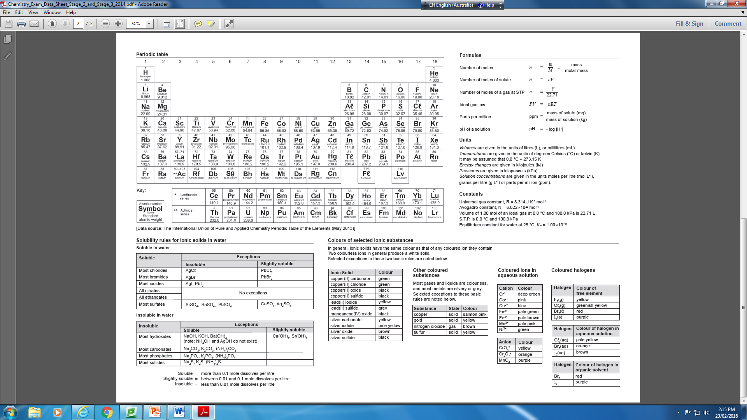
Use a solubility table

Slide 21
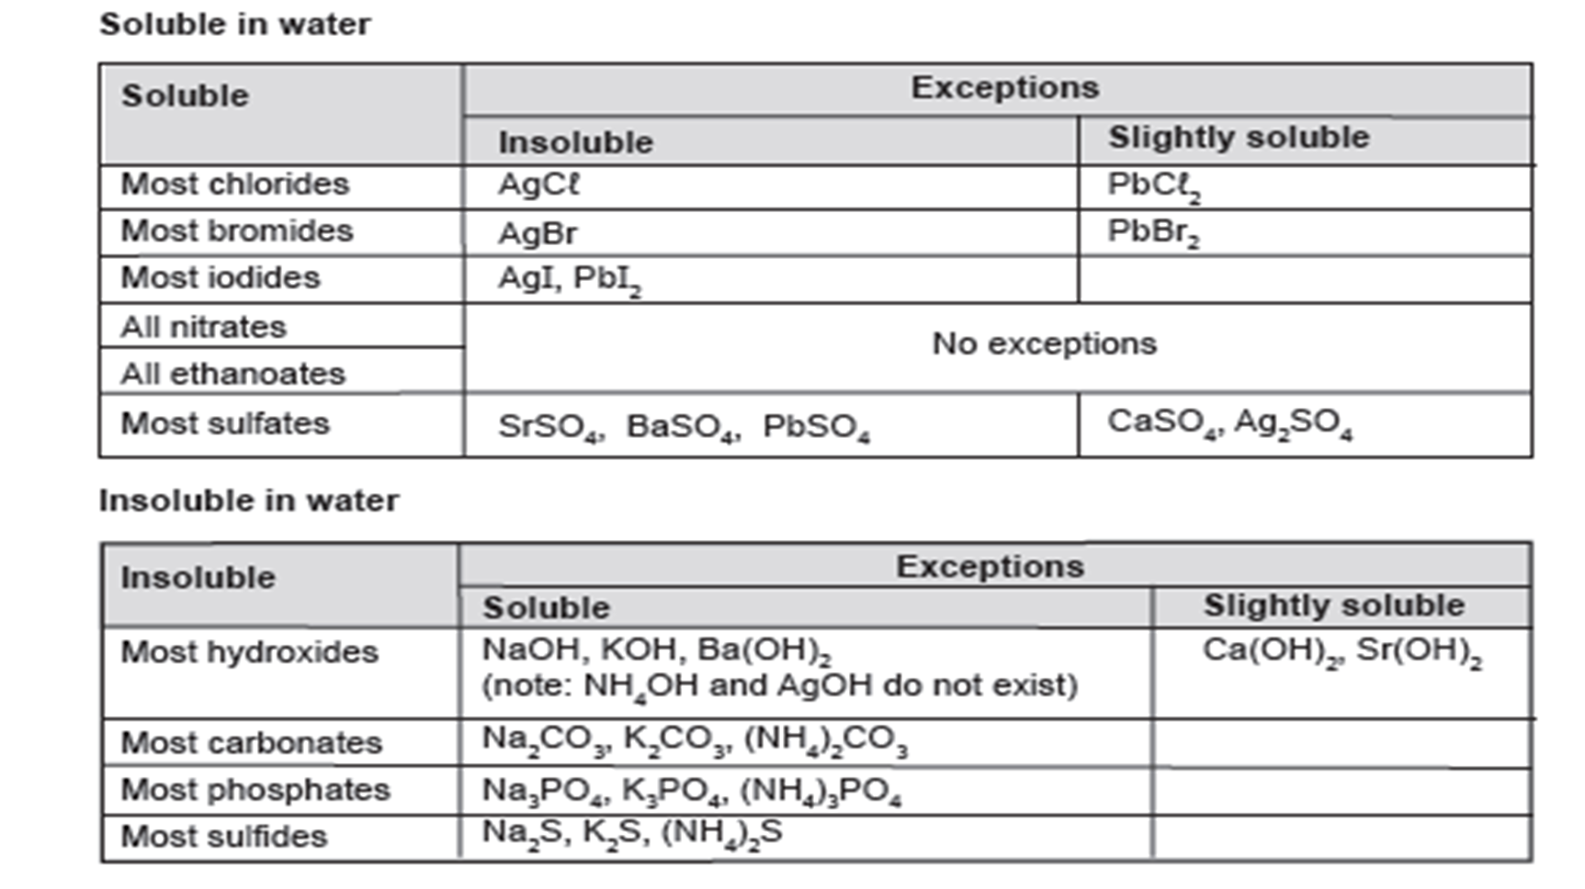
Soluble or Insoluble
Is barium sulfate BaSO₄ soluble or insoluble?
Find sulfates on the solubility table
Are sulfates soluble or insoluble?
Is Barium an exception?

